Slide 1
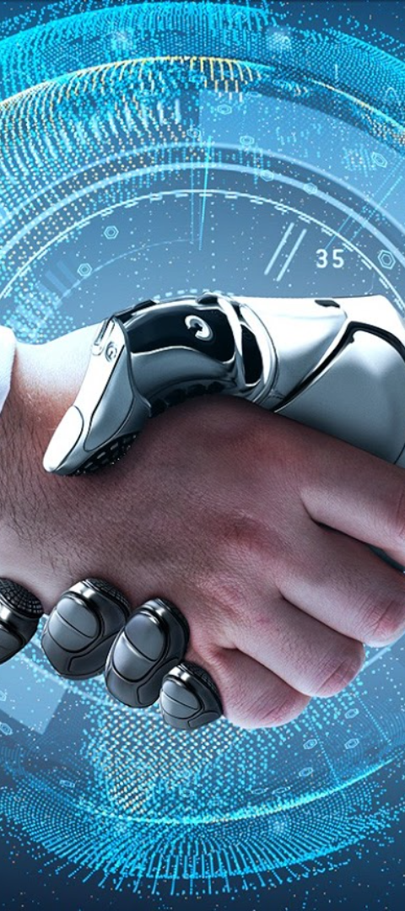

AI-Powered Image Search System
Kr
by Kariim reda

Slide 2


Kareem Ahmed Reda
Artificial Intelligence Engineer

Slide 3

Agenda
Introduction
Similarity Metrices
Project Overview
Image Processing
Tools and Technologies
Displaying Product Details
Project Overflow
Similar Product Recommendations
Dataset Collection
Testing
Model Training
Conclusion

Slide 4

Introduction
Enhancing Customer Experience with AI in E-commerce
Brief overview: Today, we'll explore how to create an AI application using Python for an e-commerce company. The goal is to enable users to get detailed product information and discover similar items through image recognition.

Slide 5

Project Overview
Project Scope
Our objective is to develop an AI application that can extract valuable information from images, such as product details and descriptions. Additionally, we will provide users with relevant recommendations for similar products based on the recognized category.
Key Features
Image recognition for accurate product identification.
Displaying comprehensive product details and descriptions.
Recommending similar products based on the recognized category.

Slide 6

Tools and Technologies
Python: Our primary programming language for this project.
TensorFlow or PyTorch: Choose either of these popular deep learning frameworks for building and training the image recognition model.
Flask: The web framework we'll use to create the application.
HTML/CSS: These technologies will be used to create an intuitive and visually appealing front-end web interface.

Slide 7

Project Workflow
1
Collect and Preprocess Dataset
Web scraping to gather a diverse dataset of products images and annotate them with corresponding product details.
Train Image Recognition Model
2
Utilize a pre-trained Convolutional Neural Network (CNN) such as ResNet or MobileNet for feature extraction.
3
Develop Flask Application
Fine-tune the network on our specific products dataset.
Create a user-friendly web application for seamless interaction. Implement code to extract information from user-uploaded images.
Display Product Details and Recommendations
4
Showcase product details and descriptions to provide users with a comprehensive understanding. Utilize the recognized category to recommend similar products.

Slide 8

Dataset Collection
Building a Representative Dataset
Importance: A diverse and representative dataset ensures the model generalizes well.
Steps:
Gather images of products from various categories.
Annotate the dataset with corresponding product details.

Slide 9

Image Processing
Preprocessing: During the image processing phase, we will leverage OpenCV or a comparable library to preprocess user-uploaded images. This ensures that images are formatted to meet the expectations of our Convolutional Neural Network (CNN).
Tools: OpenCV or equivalent libraries.
Process:
Normalization: Adjust image format to align with CNN input expectations.
Resizing: Standardize image dimensions for consistent processing.
Enhancement: Apply filters or adjustments to improve image quality.
Data Augmentation: Increase dataset diversity through transformations.
Outcome: Optimized images ready for feature extraction.

Slide 10

Model Training
Importance: Training our image recognition model stands as a pivotal phase in our project.
Considered Models: Transformer-Encoder or Pre-trained Convolutional Neural Networks (CNN), e.g., VGG16, ResNet or MobileNet for feature extraction.
Transfer Learning: Incorporating transfer learning is key to our strategy to Extracts high-level features from our diverse products dataset.
Fine-Tuning: Fine-tuning the last few layers of the network becomes instrumental.
Objective: This adaptation ensures that our model is tailor-made for our specific dataset.
Enhanced Performance.

Slide 11
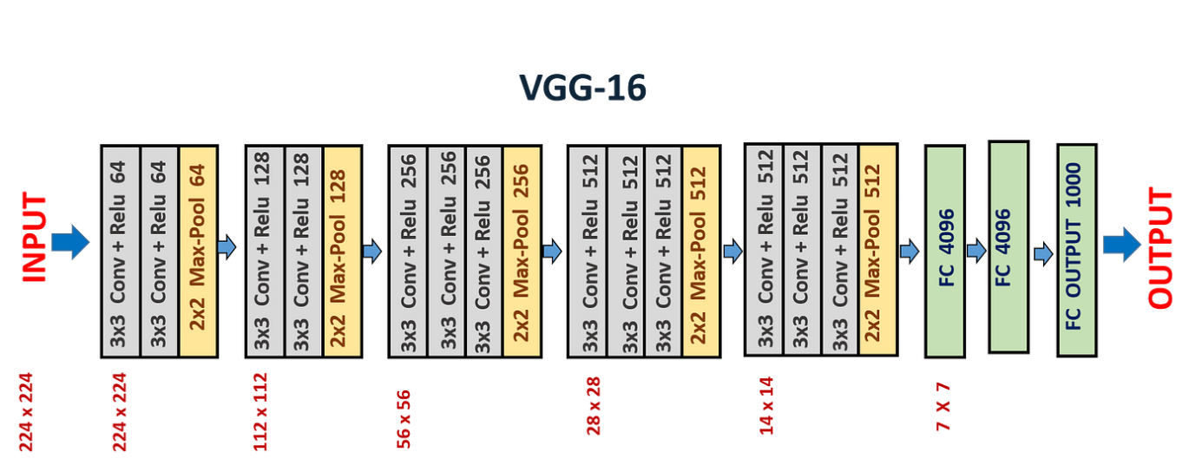
VGG Model

Slide 12

Similarity Metrics
Cosine Similarity Overview: Cosine similarity measures the similarity between two non-zero vectors (feature vectors extracted from images) by calculating the cosine of the angle between them to find relationships between feature vectors in our model.
Key Concepts:
Vector Representation: Two vectors, A and B, represent features in a multidimensional space (e.g., pixel intensities in images).
Dot Product: Calculates the sum of the product of corresponding components of vectors A and B.
Magnitude of a Vector: Obtained using the Euclidean norm, representing the length of a vector.
Cosine Similarity Formula: Similarity (A, B) = AB/||A||*||b||

Slide 13
Similar Product Recommendations
Metric Selection: Choosing the most appropriate similarity metric based on the nature of our data is paramount.
Similarity Scores: We will calculate similarity scores between recognized product categories using the selected metric.
User-Centric Sorting: By sorting the products based on these scores, we can curate and present the top matches to the user.
Highly Relevant Recommendations: This approach ensures that our users receive highly relevant recommendations, enhancing their experience in discovering similar products of interest.
Seamless Discovery: Our aim is to provide users with a seamless and enjoyable experience, making the process of discovering similar products effortless and engaging.

Slide 14

Displaying Product Details
User-Friendly Product Information
Visual Appeal: With a visually appealing HTML/CSS interface, our aim is to create a user-friendly display.
Comprehensive Details: The display will showcase not only the product name and description but also other pertinent information. This approach ensures a comprehensive understanding of the item.
Clean and Intuitive: Our goal is to design an interface that is clean and intuitive.
Enhanced User Experience: This approach collectively enhances the overall user experience, making navigation seamless and information readily accessible to our users.

Slide 15

Testing and Optimization
Fine-tuning and Enhancing Performance
Testing: To deliver a high-performance AI application, testing is an indispensable step.
Performance Enhancement: Our commitment is to ensure that our AI application performs optimally, delivering accurate and reliable results across a diverse range of product categories.

Slide 16
Conclusion
In conclusion, we have successfully developed an AI-powered product recognition system for our e-commerce company. By leveraging the power of AI and image recognition, we are able to provide our users with detailed product information and valuable recommendations, enhancing their overall shopping experience. This technology opens doors to endless possibilities in the world of e-commerce and showcases the potential of AI-driven solutions in transforming customer experiences.

Slide 17
Any Questions?

Slide 18

Thank you!

